Slide 1
Laptop Setup

Slide 2
Step 1. Install software
VS Code https://code.visualstudio.com/ Editing python programs. Use the "System Installer".
Python 3 https://www.python.org/ It's python. Install in c:\python\ (use the "custom installation" option)
git for Windows https://git-scm.com/downloads Be sure to select VS code as your default editor.
pybricks https://pybricks.com/ https://code.pybricks.com/ and https://beta.pybricks.com/ Nothing to install on your computer, but you will need to install it on your robot.

Slide 3
Step 2. Create github account
http://github.com
You will need a phone or yubi key to set up 2FA
Do NOT forget your username and password.

Slide 4
Step 3. Invite each member as a collaborator
One of the coaches will invite you to be a collaborator on the team repository

Slide 5
Step 4. Accept invitation
Look at your github notifications. Click “accept”

Slide 6
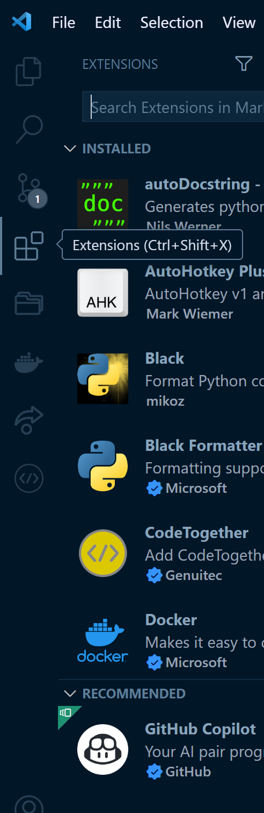
Step 5. VS Code Extensions
Open VS Code and install the following extensions
Error Lens
Git Autoconfig
GitHub Pull Requests
Python/Pylance
Black Formatter
PDF Viewer
Restart VS Code
Clone the Team’s Repository and open the project

Slide 7
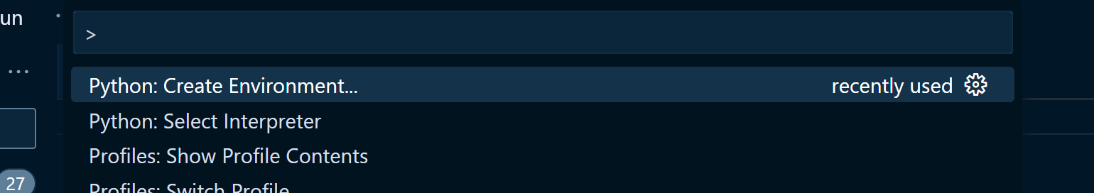
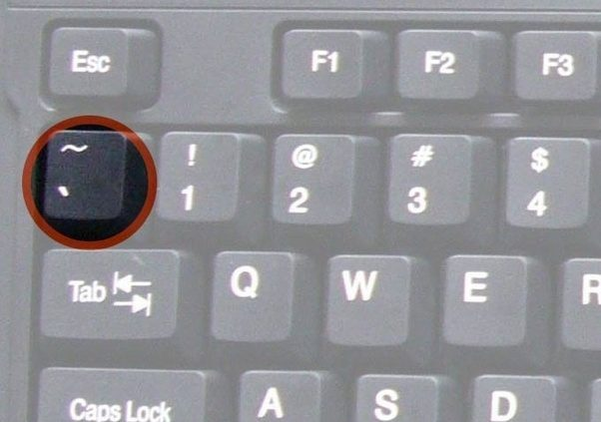
Step 6. Add Python Virtual Environment
Add a python virtual environment.
Ctrl-Shift-P > Python: Create Environment. Just use the defaults.
Pro-tip: Try typing Ctrl-Shift-P, then “cre env”
Open PowerShell
Set-ExecutionPolicy RemoteSigned
Pro-tip: Just type “set-ex” and then hit Tab, then type “re” and then hit Tab
Will need admin password
Restart VS Code
Open a new terminal with ctrl-shift-` or Ctrl-Shift-P > Create Terminal and make sure it is in the python virtual environment. It will start with a green "(.venv)".

Slide 8
Step 7. Python and Git Requirements
pip install -r .\requirements.txt
should do the same thing as pip install pybricks==3.3.0a5, pip install pybricksdev and pip install black
git config --global user.name “YourName"
git config --global user.email “yourEmail@example.com"

Slide 9
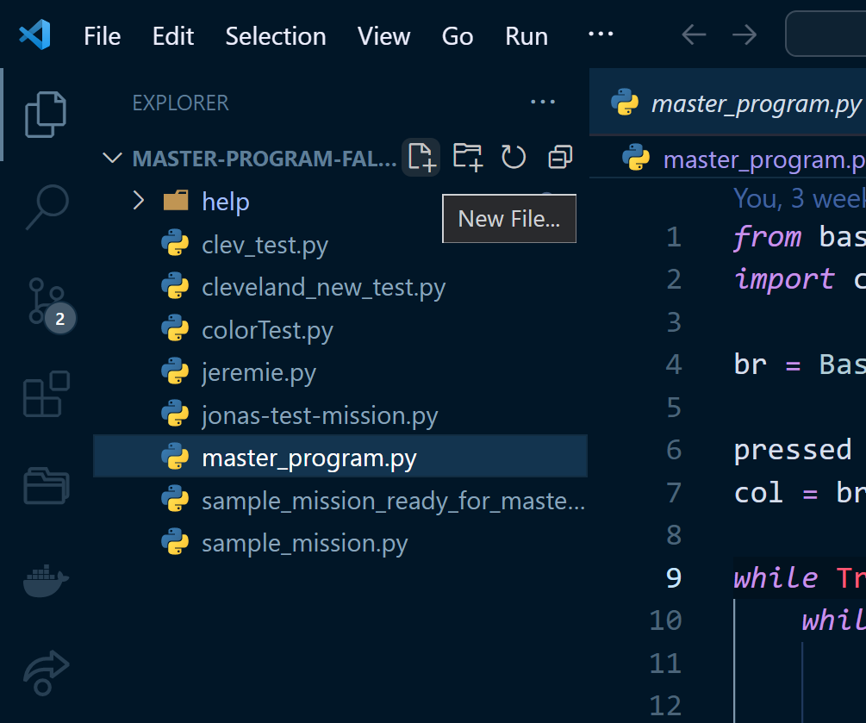
Step 8. Create Test File
Create a new python file, named teamMemberName-test-mission.py. Keep it all lowercase and no spaces. It MUST end with “.py”
Copy and paste the code from the team github page, and save it
Note that after saving the file, the python Black Formatter should correct the "incorrect" spacing around the equals signs and commas.

Slide 10
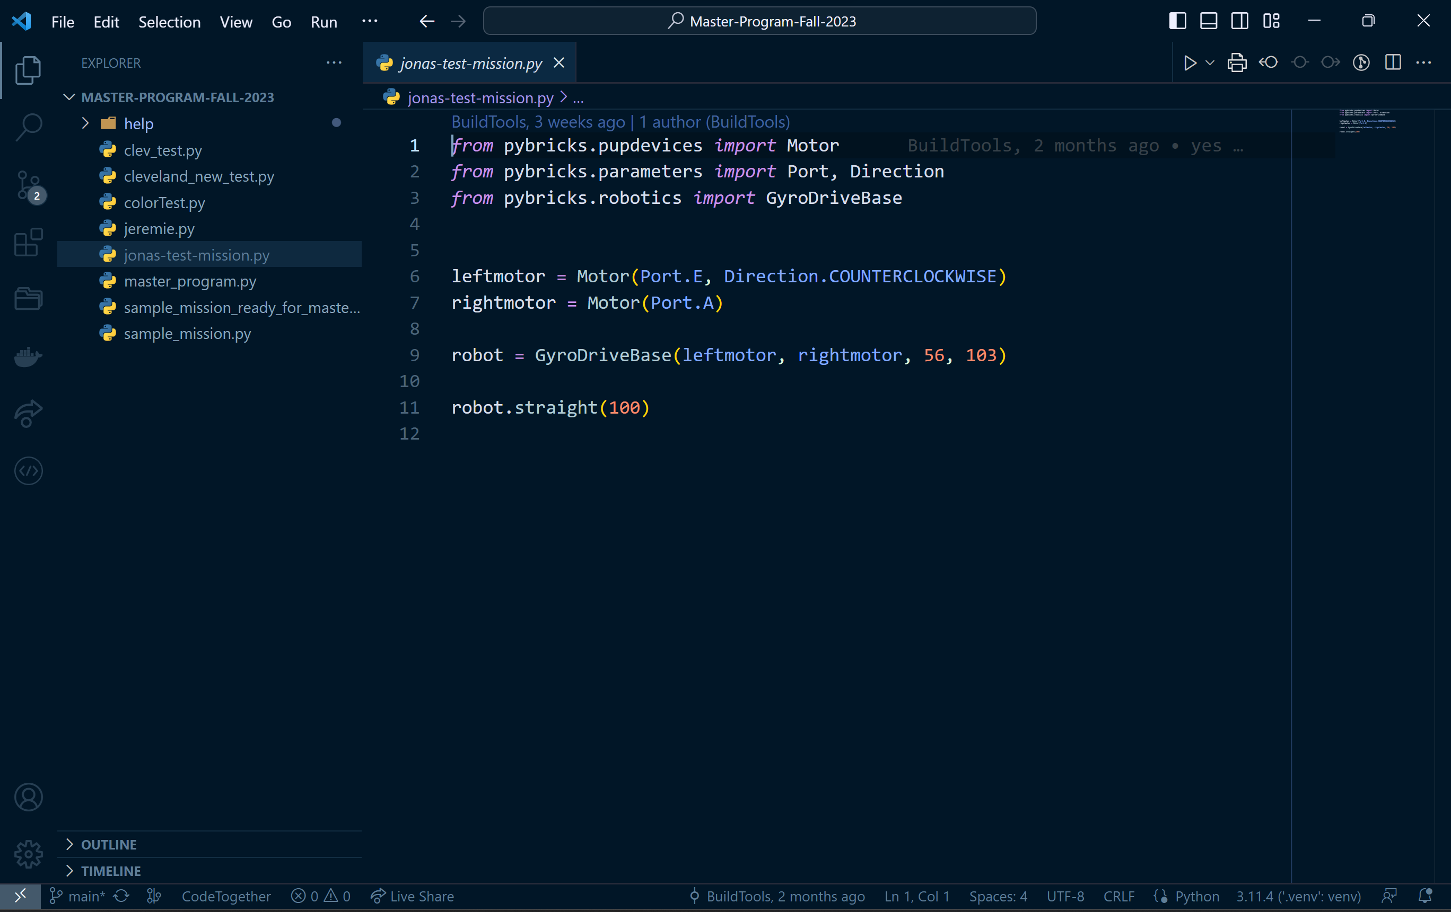

Slide 11
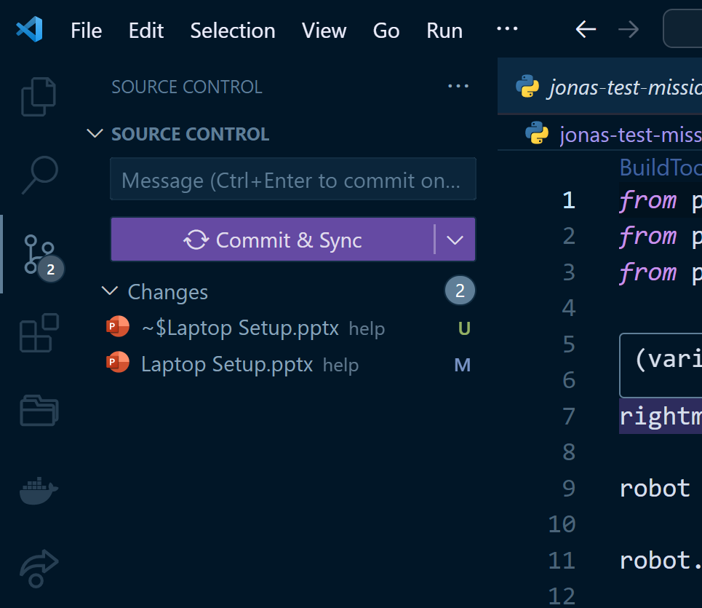
Step 9. Commit Changes
Commit the changes, and push. It will probably prompt for github registration/login and then sync all files.
Just follow the prompts back to the github webpage that we left open
2
3
1

Slide 12
Step 10. Install Pybricks
Install pybricks on each robot at https://beta.pybricks.com/
If the computer has never connected to a pybricks hub, you will probably need to manually install the USB drivers
Name the robot at this time
Avoid spaces and special characters in the robot name
Put a label sticker on the top of the robot with the robot name.

Slide 13
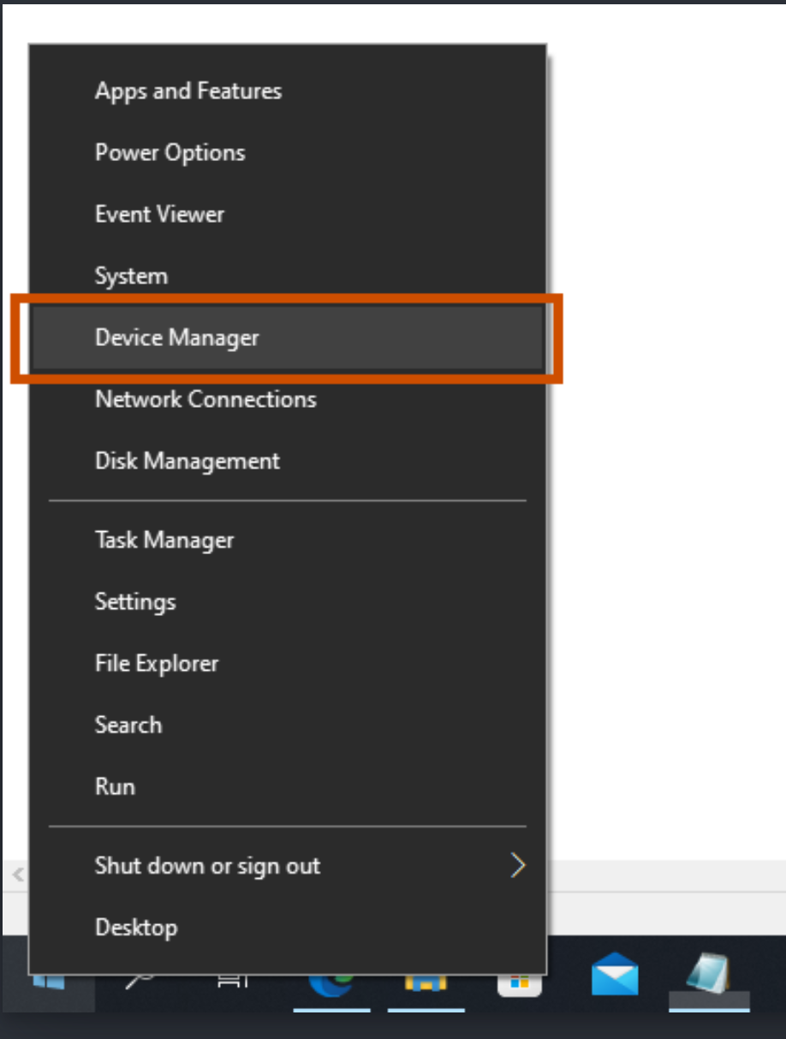
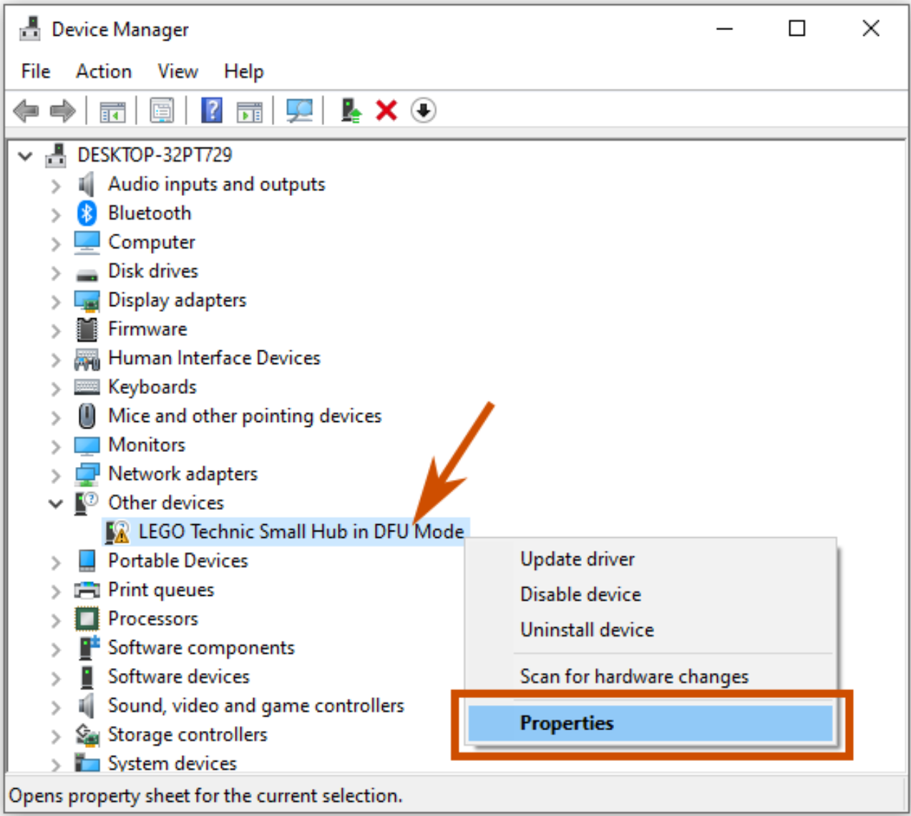

Slide 14
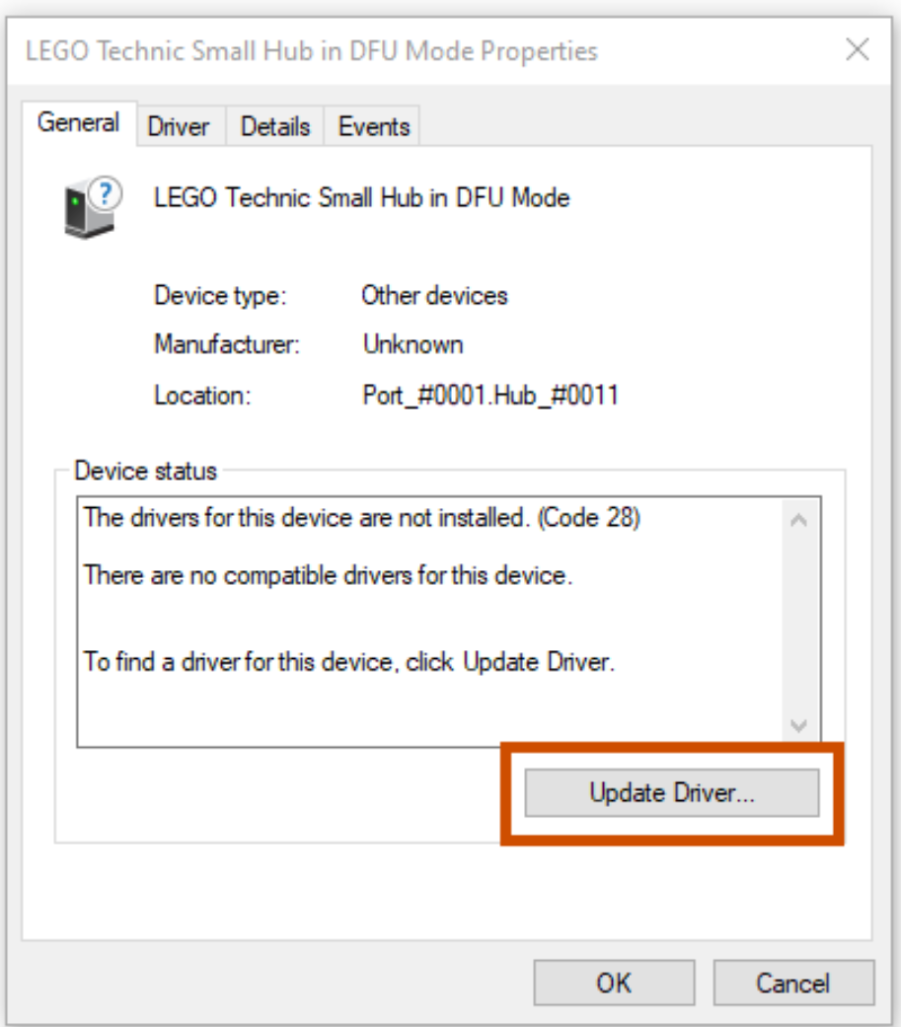
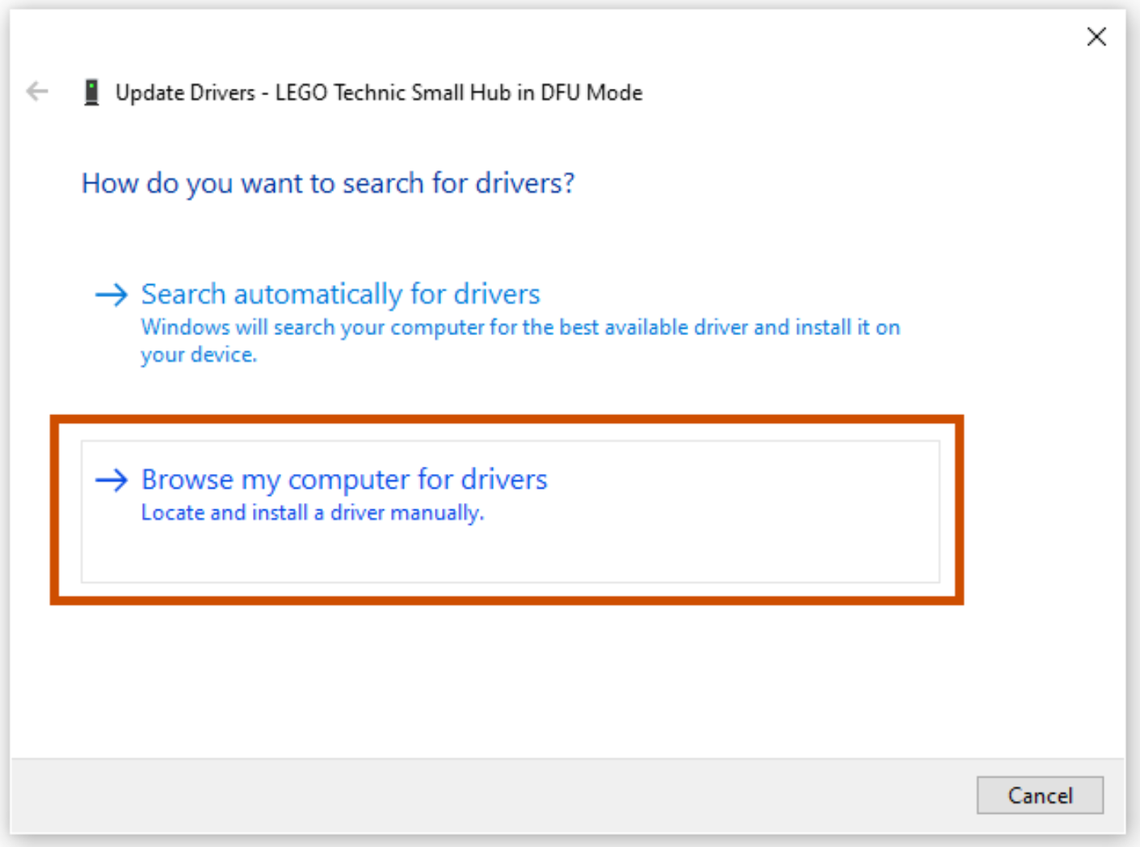
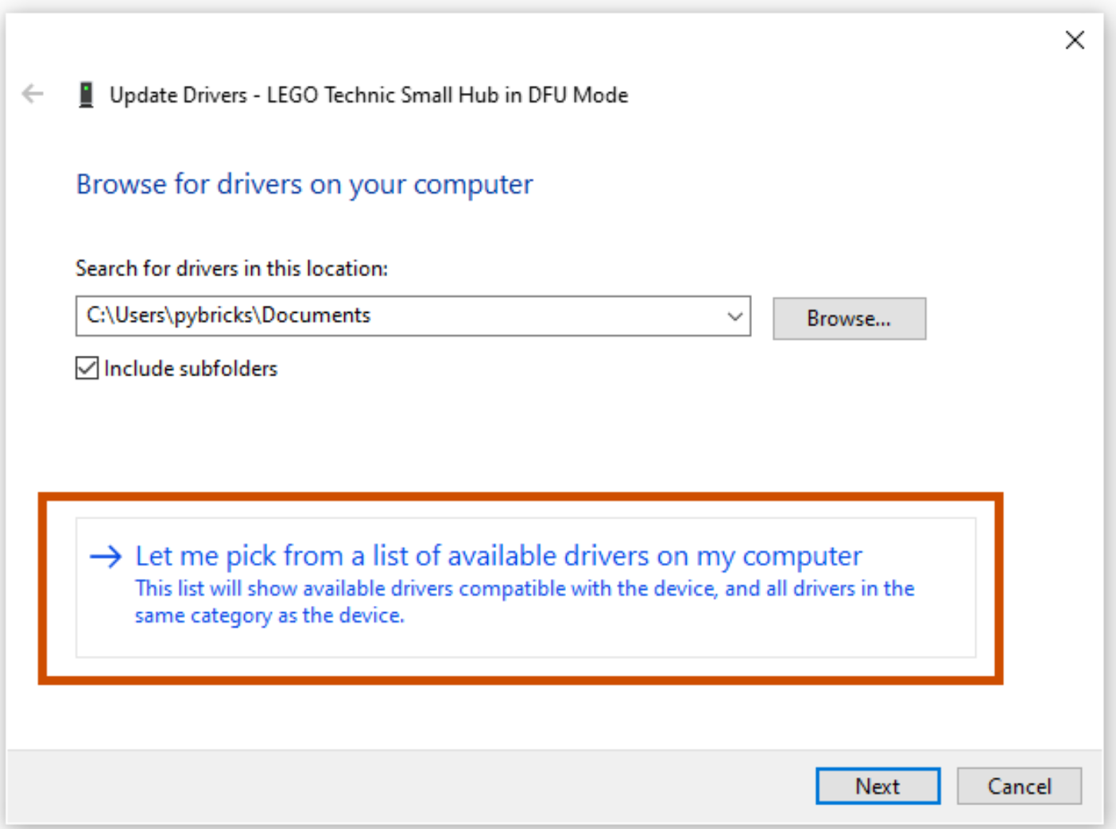
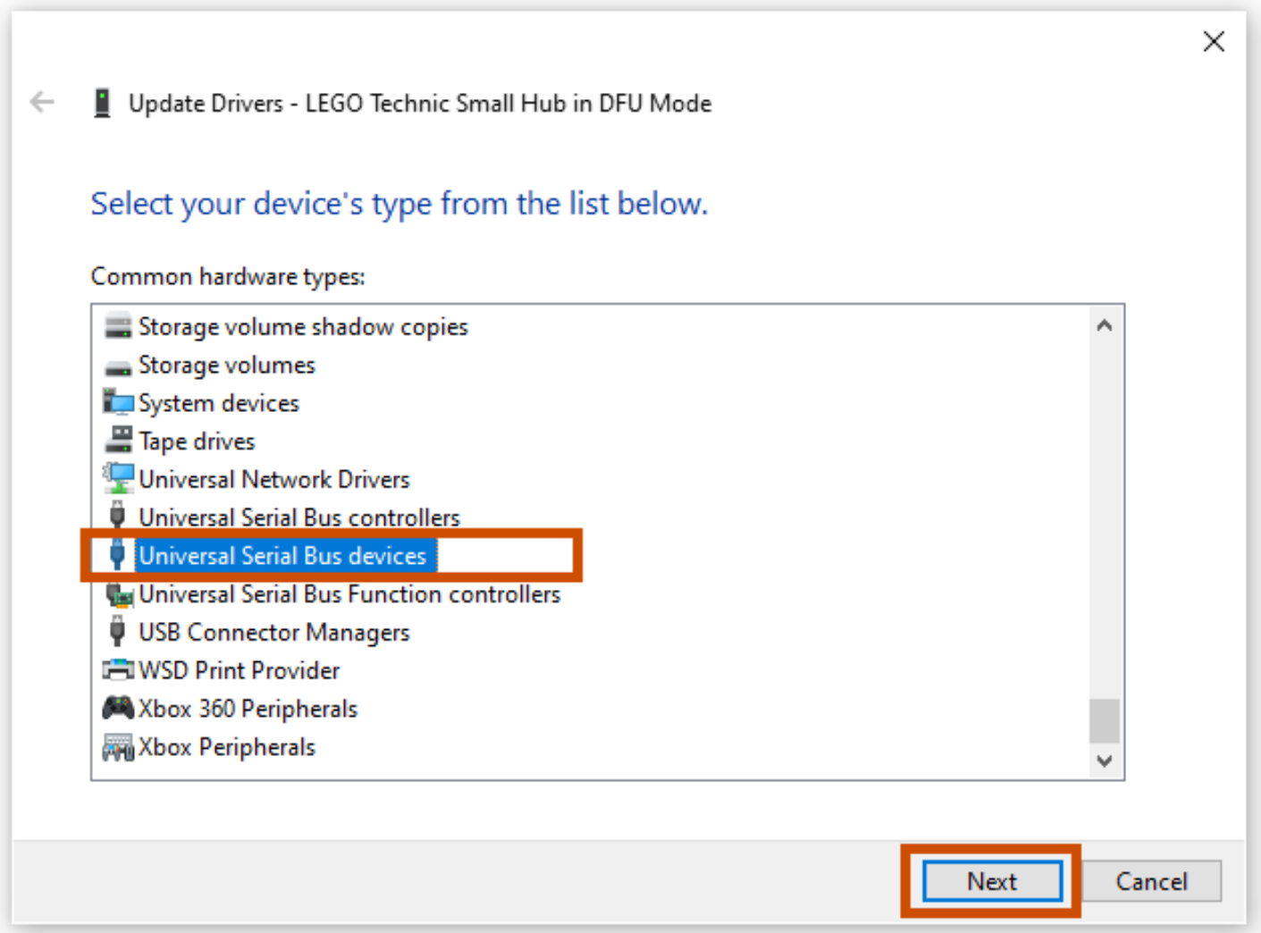
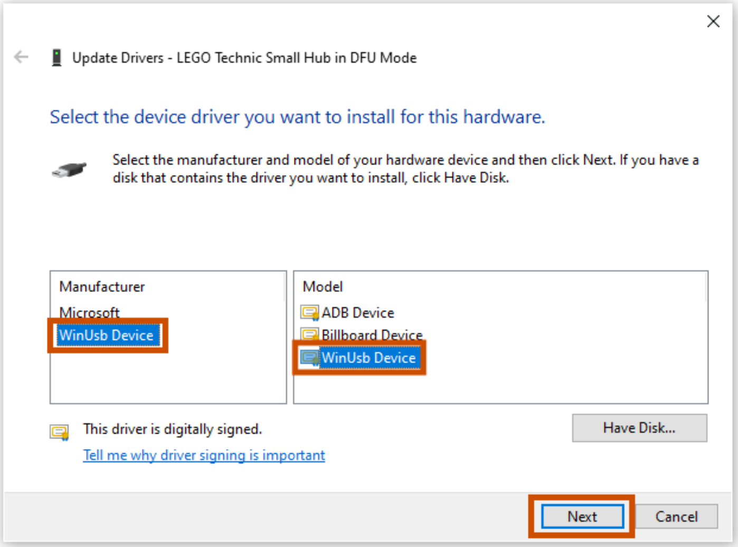

Slide 15
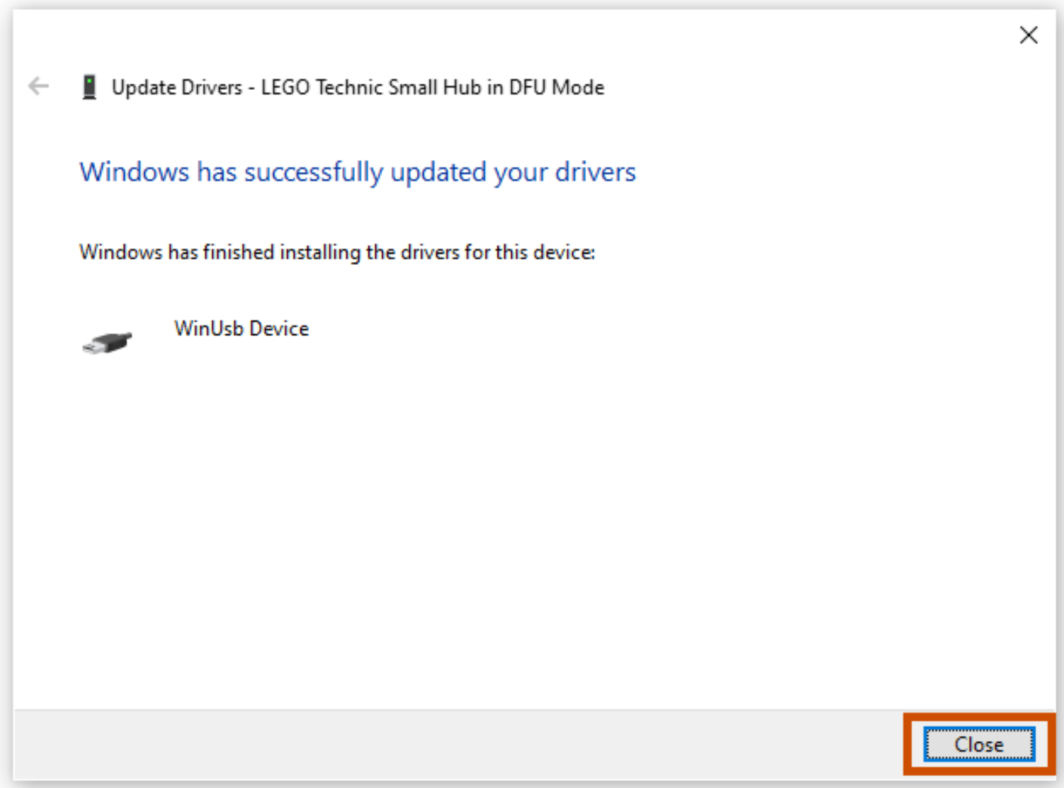
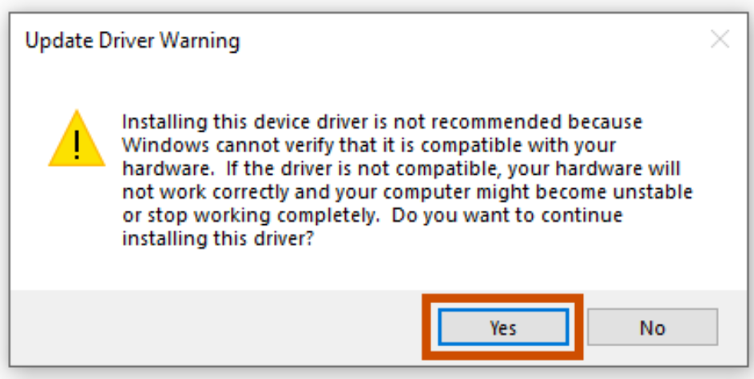

Slide 16
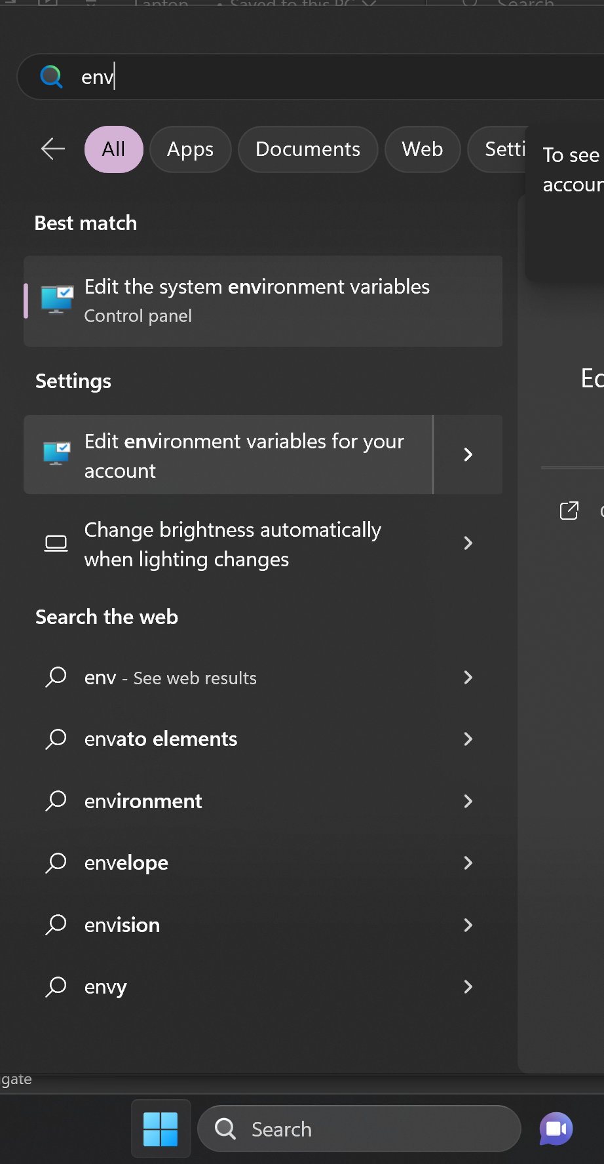
Step 11. User Environment Variables
2
Create a User environment variable for the robot name
Set the variable robotName to the name of the robot
This should allow the keyboard binding and tasks to recognize the robot by name
Restart VS Code and open a new terminal and then test it with echo $env:robotName
1: Click on Start Menu
2: Type “env”
3: Click on “Edit Environment Variables for your account”
3
1

Slide 17
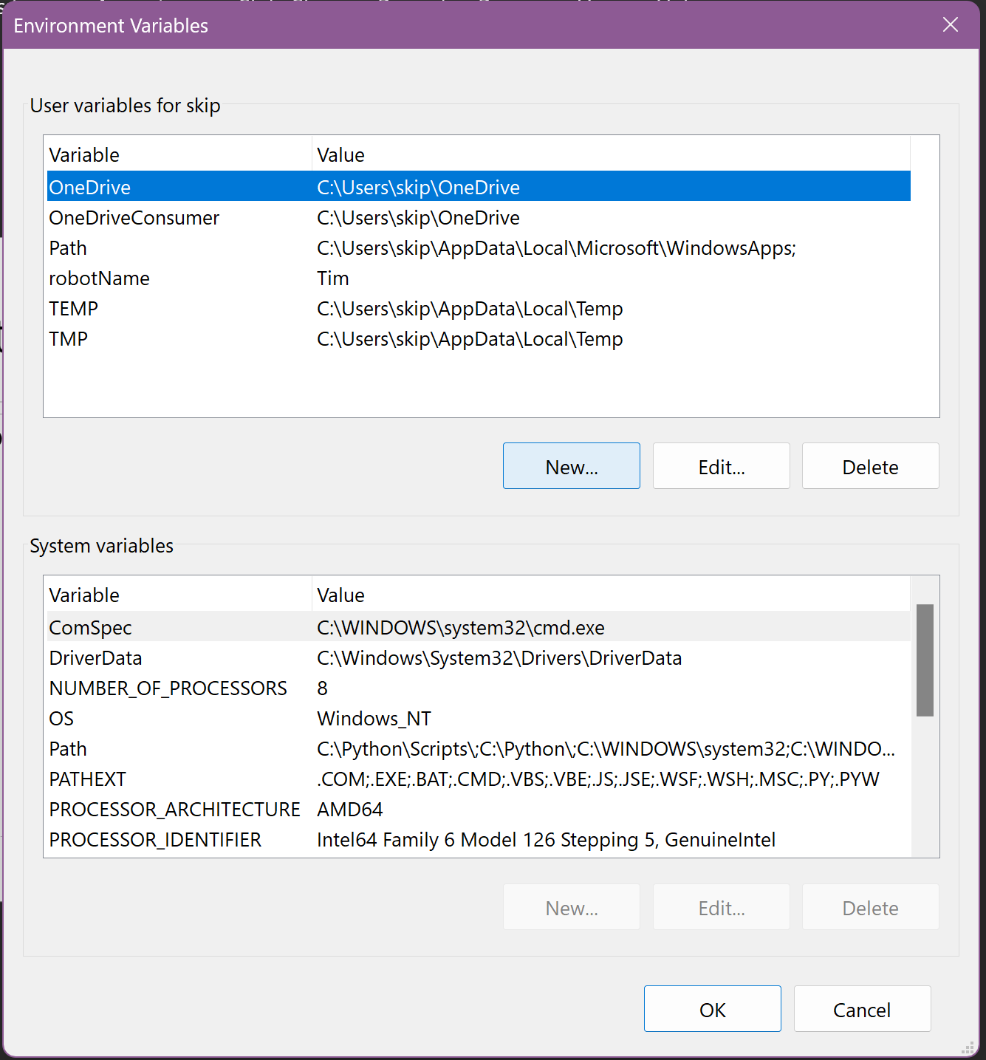
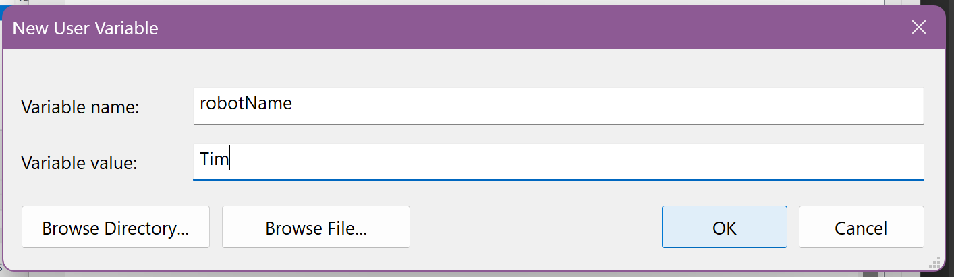
Enter “robotName”
Enter YOUR robot’s name

Slide 18
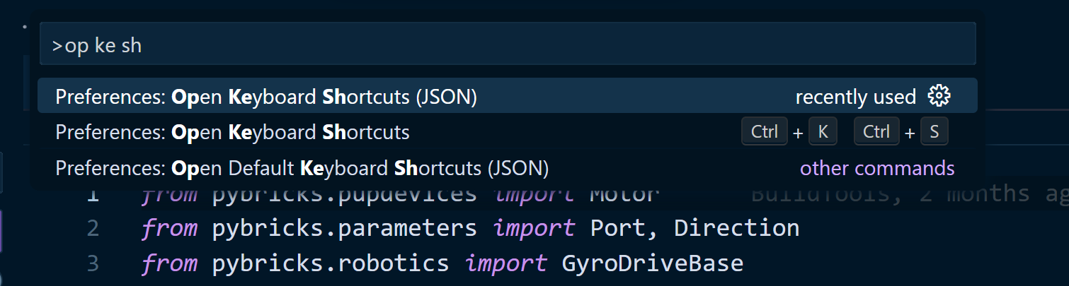
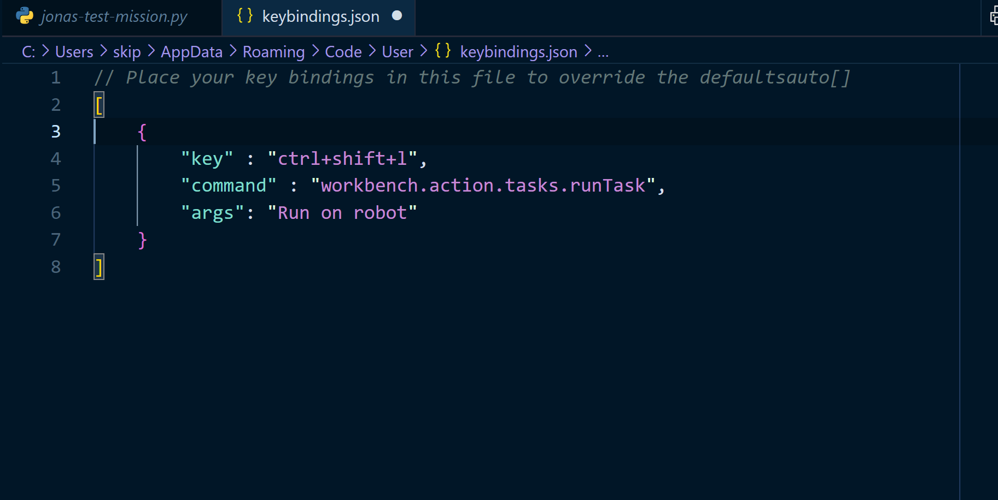
Step 12. Keyboard Shortcut
Last step, I promise! Add a keyboard shortcut to run the programs that we write. Ctrl-Shift-P > Preferences: Open Keyboard Shortcuts (JSON).
Pro-tip: type Ctrl-Shift-P, then type “op ke sh”.
Make sure you choose the entry that says “JSON” at the end
Edit the JSON to add the keyboard shortcut to run the task. Paste in the code below at the bottom of keybindings.json.

Slide 19
Step 13.
RUN OUR PROGRAM!
Turn the robot on and ensure the keyboard shortcut ctrl-shift-L runs the command, which should also run their program
Also, Ctrl-Shift-P > Tasks: Run task should pop up a menu with the correct entry
Watch the terminal and make sure the robot name is correct. If not, recheck that you completed step 11 correctly.

